Slide 1
Chapter 9
SINGLE-SAMPLE T TEST

Slide 2
The t Distributions
z test works well…when you know population parameters
What happens when you don’t know the population parameters?
Use the t distribution (t test)
  determine probabilities when σ is unknown

Slide 3
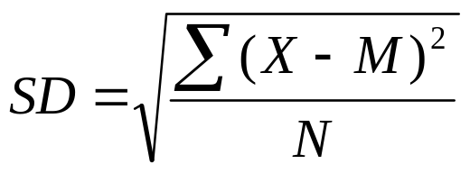
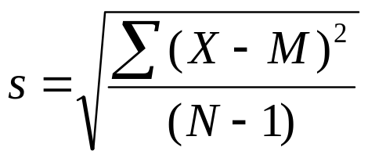
Estimating σ
We can use SD as an estimate
But, we need to make a correction
  Sample standard deviation (SD) always underestimates population standard deviation (σ)

Slide 4
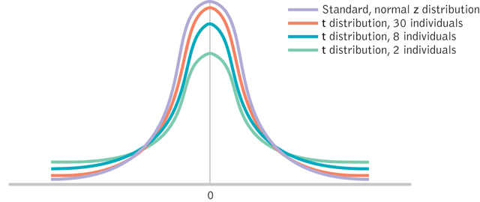
The t Distributions

Slide 5
Degrees of Freedom
identify a particular t distribution by its degrees of freedom (df)
degrees of freedom = the number of scores that are free to vary when estimating a population parameter from a sample
df = N - 1

Slide 6
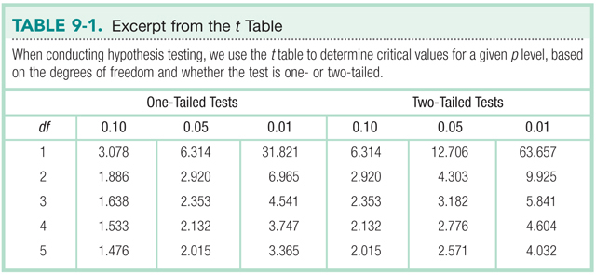
The t Table

Slide 7
The Single-Sample t Test
compare one sample to a population
population mean (µ) is known
population standard deviation (σ) is unknown
When people choose a number between 1 and 10, the mean is 6. To investigate the effects of subliminal stimuli on behavior, a researcher embedded many low numbers (1 to 3) in a video clip.
  N = 30; M = 5.40; s = 2.27

Slide 8
Step 1: Identify
Populations
  General population, µ=6
  Population of individuals exposed to subliminal stimuli
Comparison distribution
  distribution of means
Hypothesis test
  single-sample t test
Assumptions
  DV is scale
  Convenience sample
  N = 30

Slide 9
Step 2: H₀ & H₁
H₀ : No difference between populations
  H₀ : μ₁ = μ₂
H₁ : There is a difference between populations
  H₁ : μ₁ ≠ μ₂

Slide 10
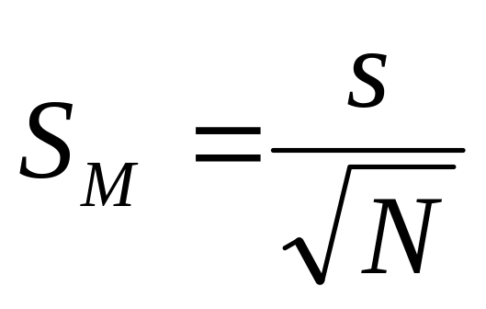
Step 3: Identify the Sampling Distribution
μ_{M} = μ = 6
S_{M} = 2.27 / √(30) = 0.41

Slide 11
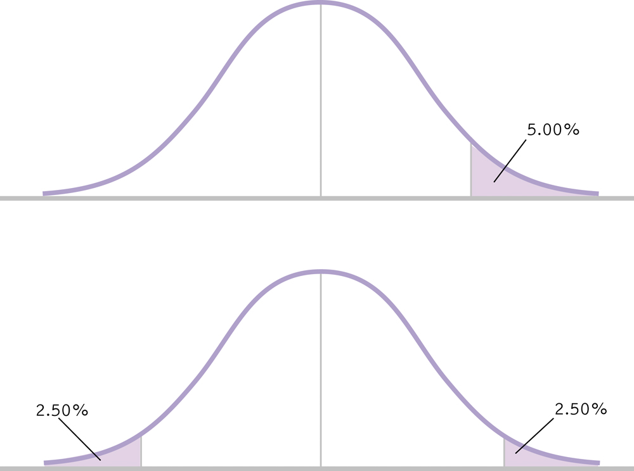
Step 4: Determine Critical Values
Two-tailed, α = .05
df = N -1 = 30 – 1 = 29
-2.045
2.045

Slide 12
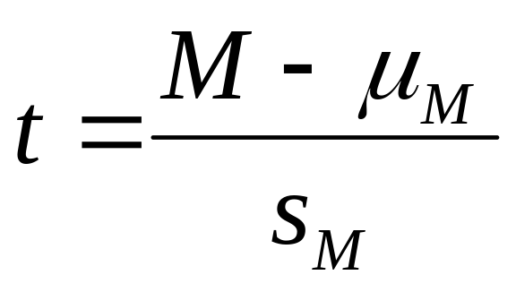
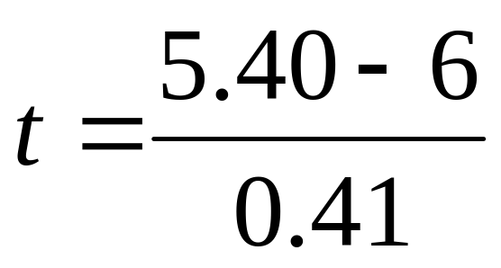
Step 5: Calculate t
t = -1.46

Slide 13
Step 6: Make a Decision
Is the calculated t in the rejection region?
-1.46
-2.045
2.045

Slide 14
Step 6: Make a Decision
Retain H₀
There is no significant difference between the numbers chosen by people subjected to subliminal stimuli and those who are not, t(29)=-1.46, p>.05.

Slide 15
Confidence Intervals
M_{lower} = - t(s_{M}) + M_{sample} M_{upper} = t(s_{M}) + M_{sample}
=- 2.045(0.41) + 5.40 = 2.045(0.41) + 5.40
= 4.56 = 6.24

Slide 16
Confidence Interval
95% confidence interval is [4.56, 6.24]
This interval would contain the population mean 95% of the time

Slide 17
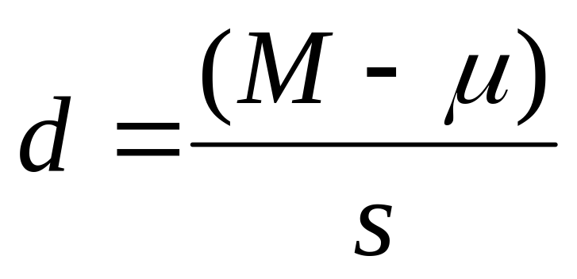
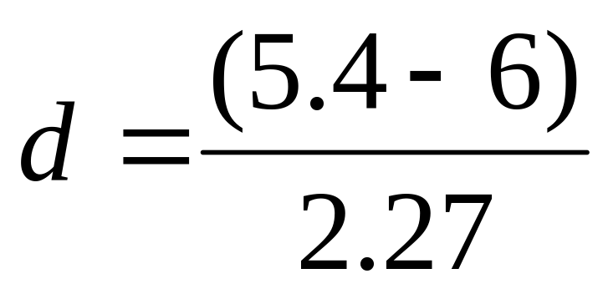
Effect Size
d = -0.26; small

